Slide 1
Letter Prediction
Cory Randolph, Abraham Kong,
Akanksha Rawat, Karishma Kuria

Slide 2
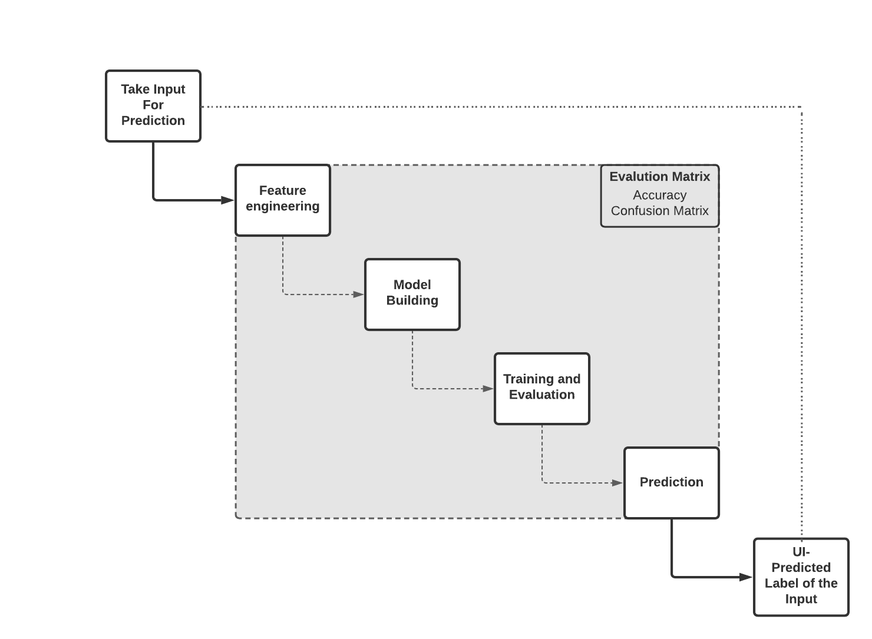
Abstract
Build an whiteboard on a front end UI
Take user drawn had written letters
Apply Machine Learning Model to classify drawing
Return a prediction based on the user’s drawn letter

Slide 3
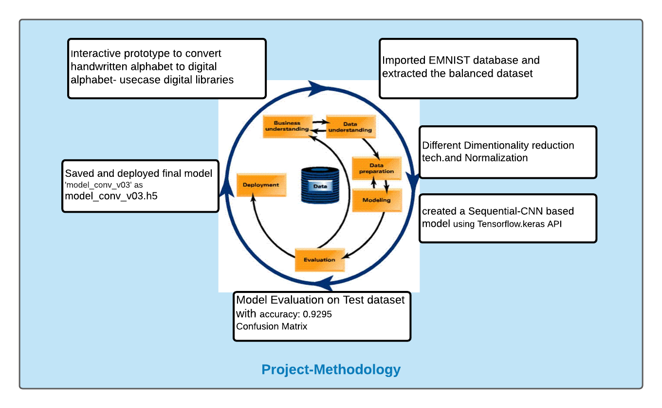
Methodology

Slide 4
Data Understanding
Imported EMNIST- balanced dataset.
The EMNIST dataset has a set of handwritten digits (0–9), (a-z), and (A-Z) being converted into 28x28 pixel pictures.
The EMNIST Balanced dataset - 47-class dataset was chosen over the By Class dataset to avoid classification errors.
​​

Slide 5
Data Preprocessing
Data Reduction Techniques used:
Principal Component Analysis (PCA)
Singular Value Decomposition (SVD)
Locally Linear Embedding (LLE)
T-distributed Stochastic Neighbor Embedding (T-SNE)
Isometric Mapping(ISOMAP)
Uniform Manifold Approximation and Projection (UMAP)
Data Normalization: The data set is divided by 255 based on the RGB codes.

Slide 6
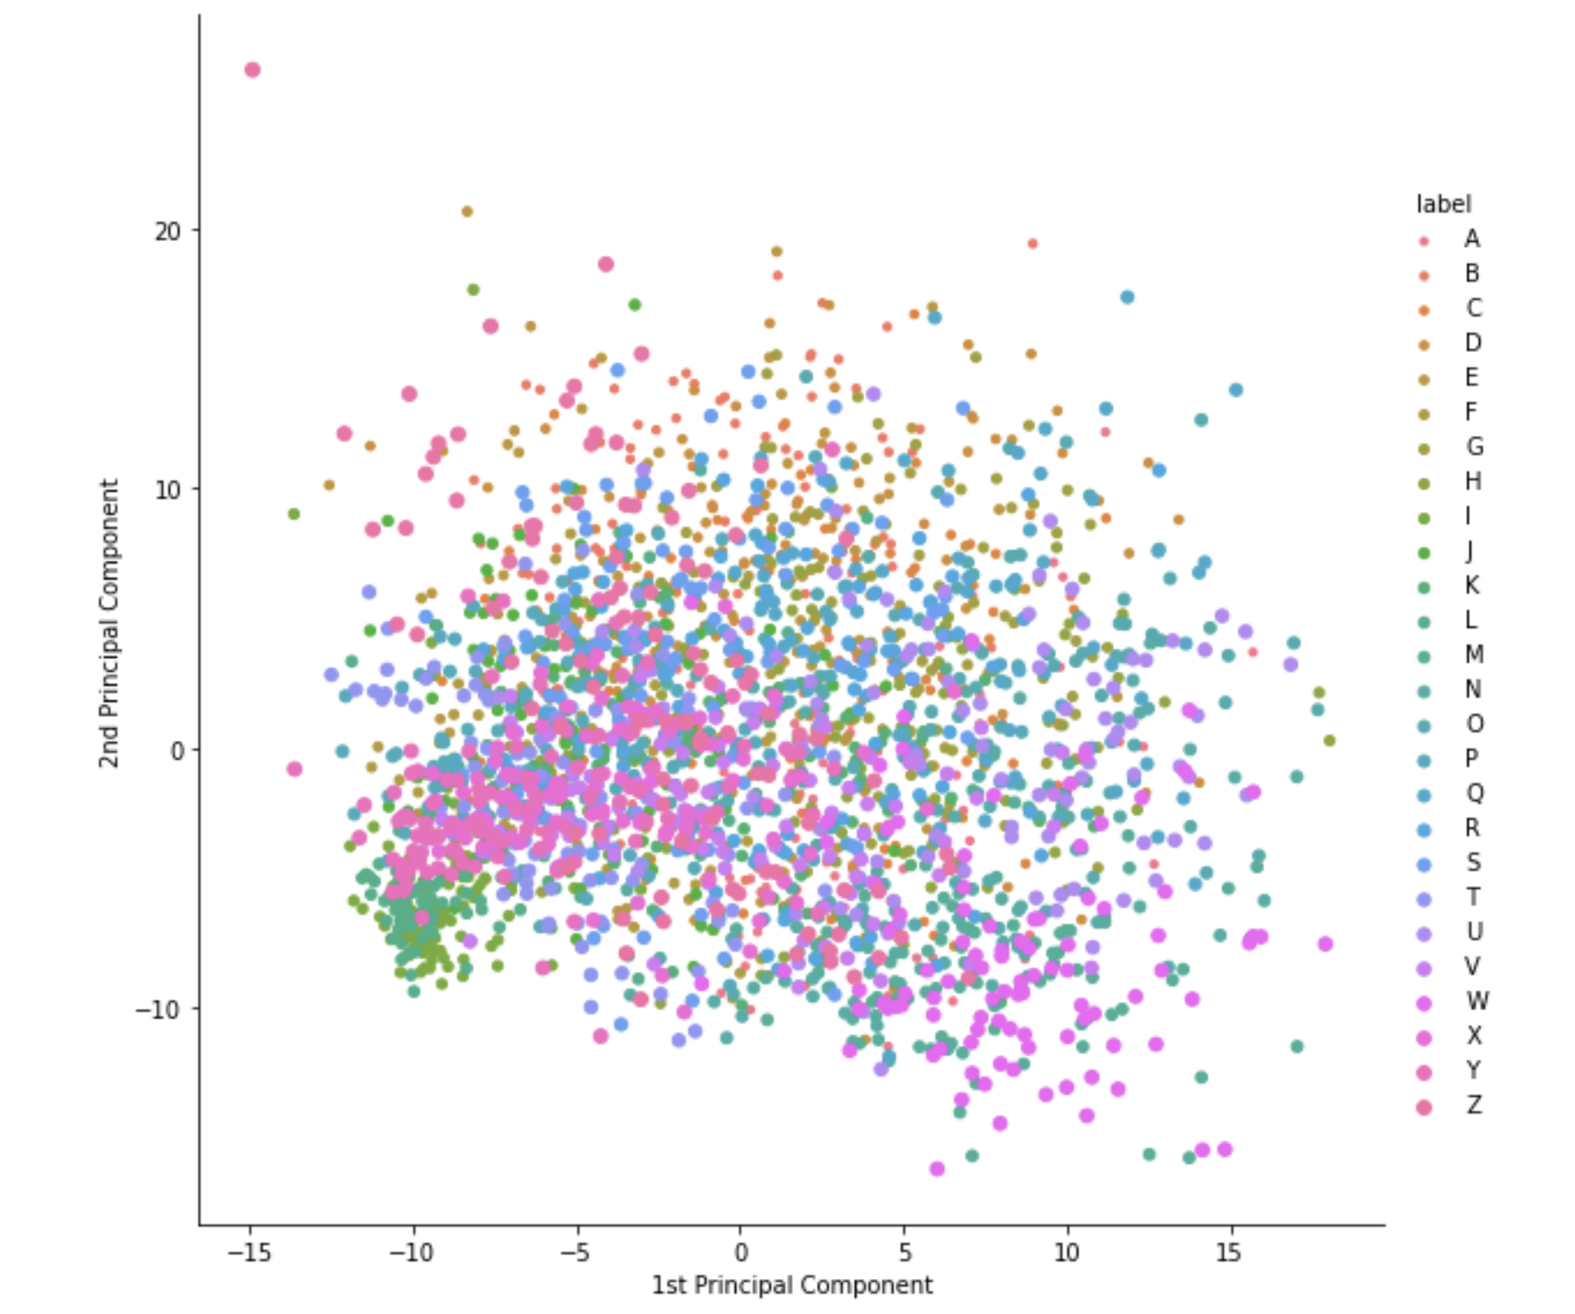
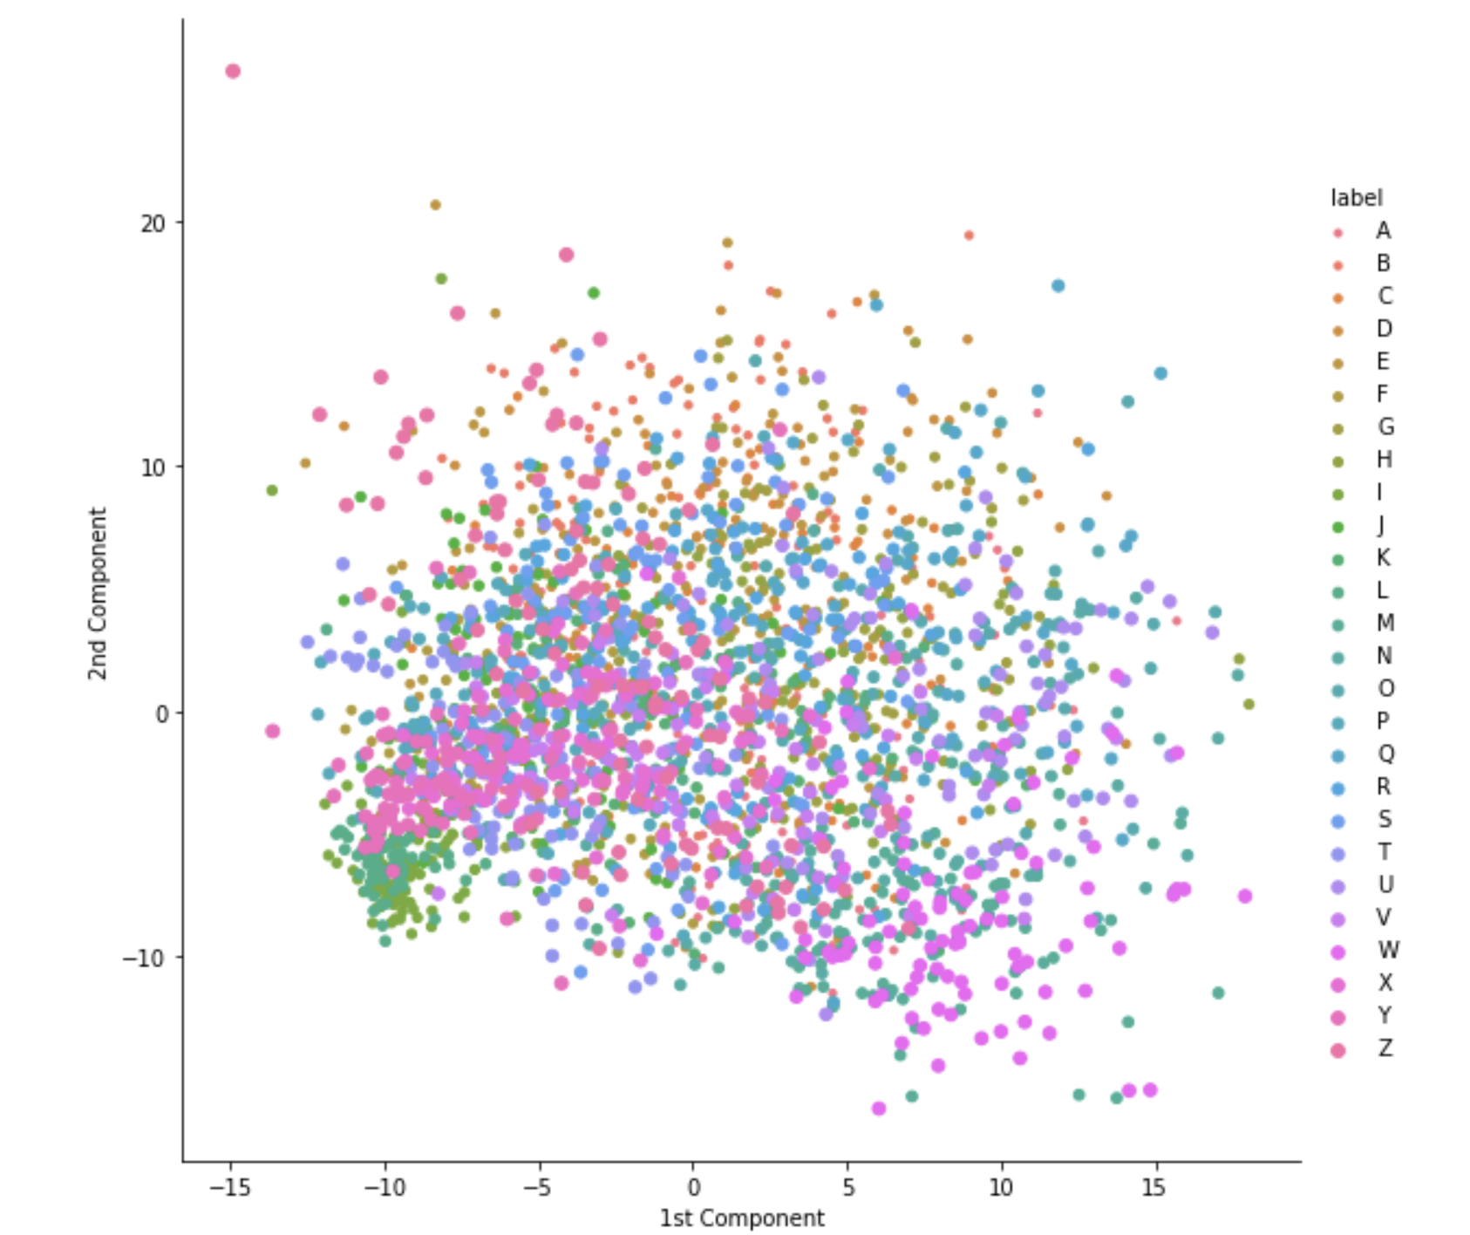
Data Reduction Visualizations
PCA
SVD

Slide 7
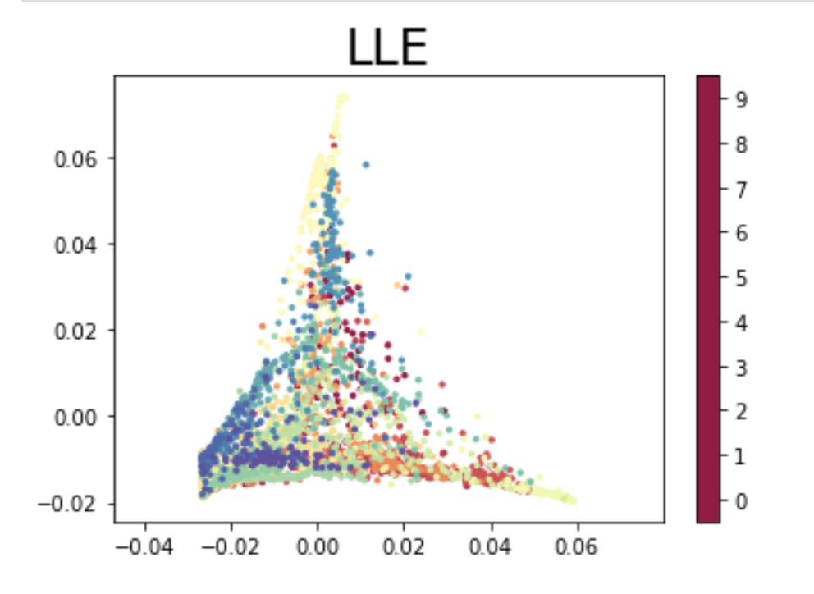
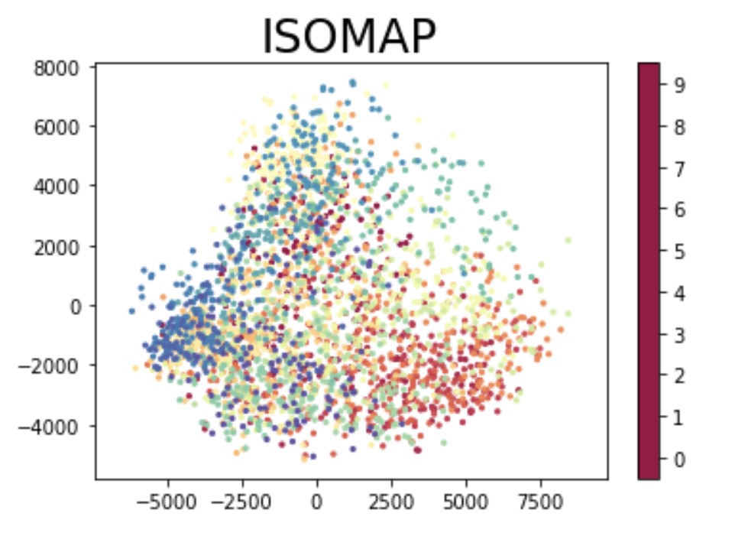
Data Reduction Visualizations

Slide 8
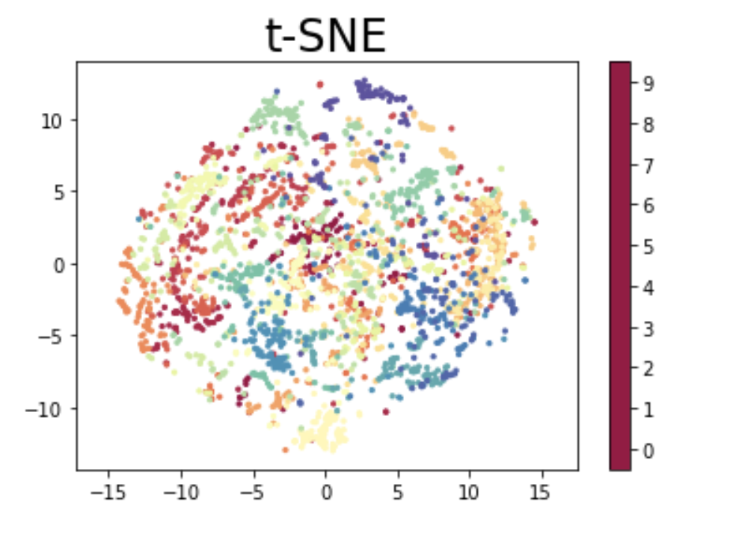
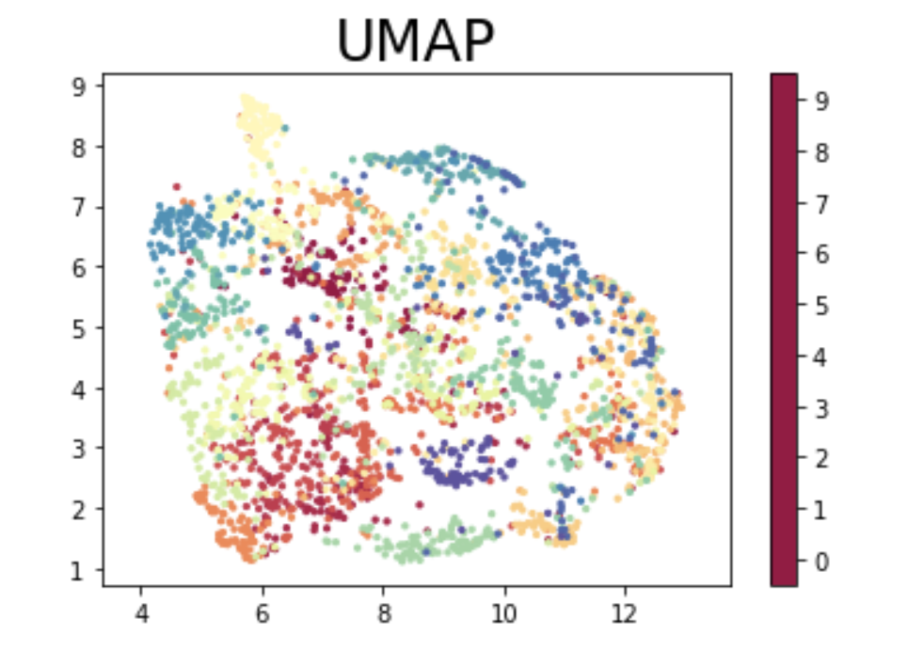
Data Reduction Visualizations

Slide 9
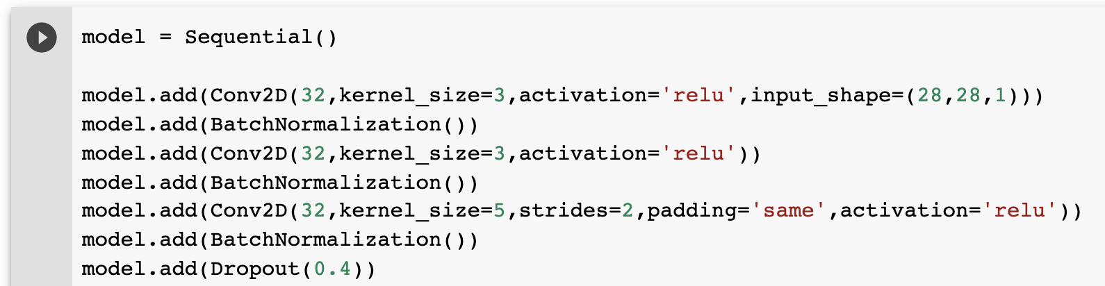
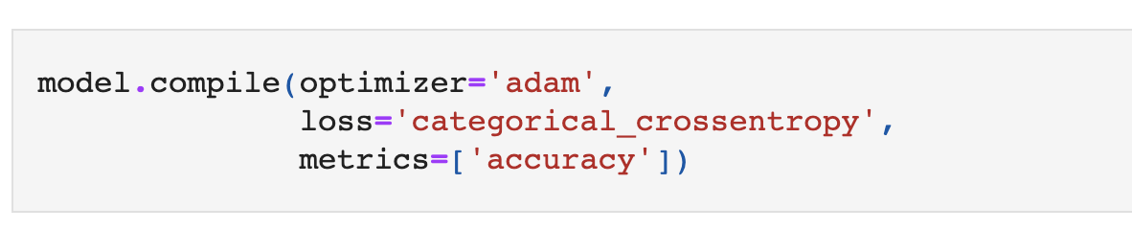
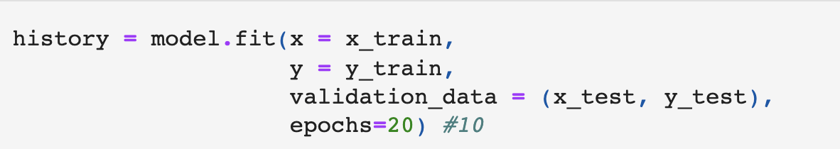
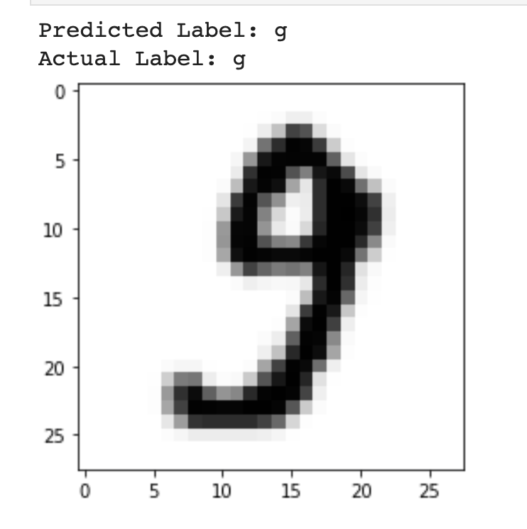
Modeling
Building the model- Using Keras- high level API of tensorflow framework build a layered sequential type Model.- Based on Convolutional Neural Network architecture. model type= Sequential()
model.add(Conv2D(32,kernel_size=3,activation='relu',input_shape=(28,28,1)))
Compiling the model- parameters [optimizer, Loss, Metrics]
model.compile(optimizer='adam',
loss='categorical_crossentropy',
metrics=['accuracy'])
Training the Model
Evaluation and Prediction
model.evaluate(x_test, y_test)

Slide 10
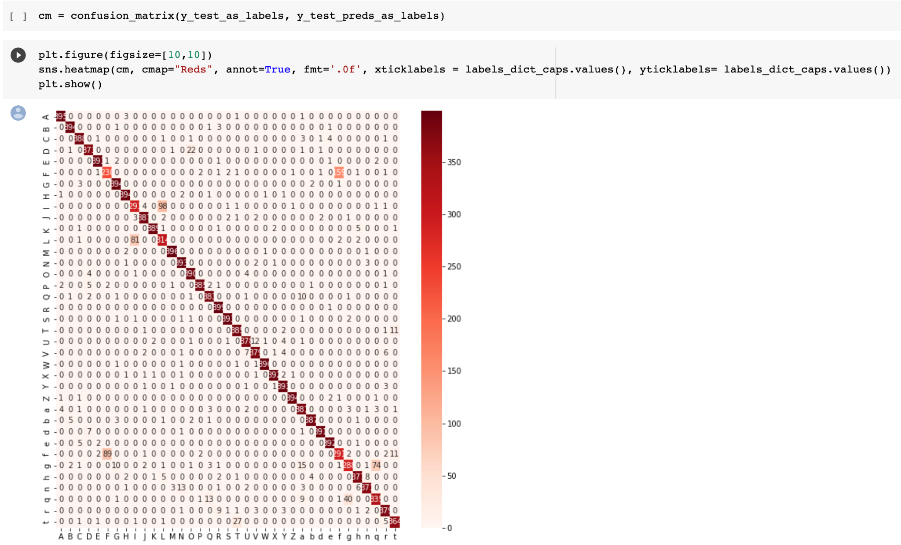
Evaluation
Evaluated on test data set. Using below measures:
Confusion Matrix
Accuracy
Loss
Precision
Recall
f1-score

Slide 11
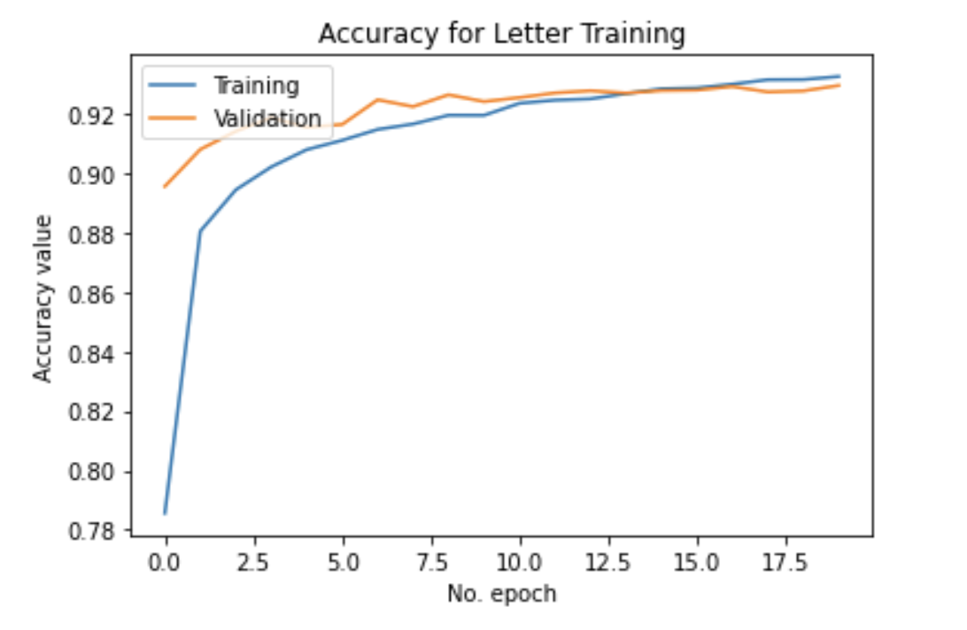
Evaluation

Slide 12

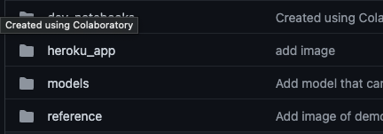
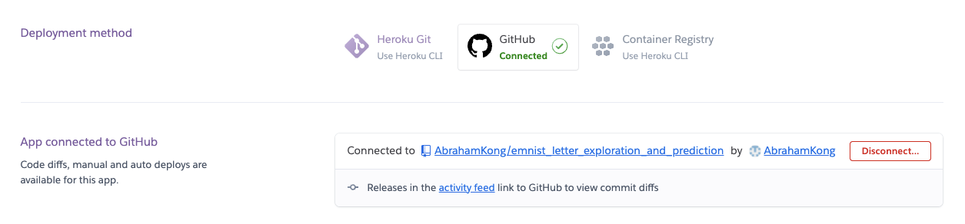
Deployment:
Heroku
We choose Heroku as our web server To deploy our app, as it is very easy to Deploy once the Github is set right.

Slide 13
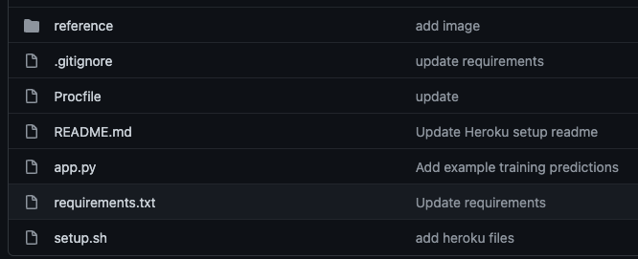
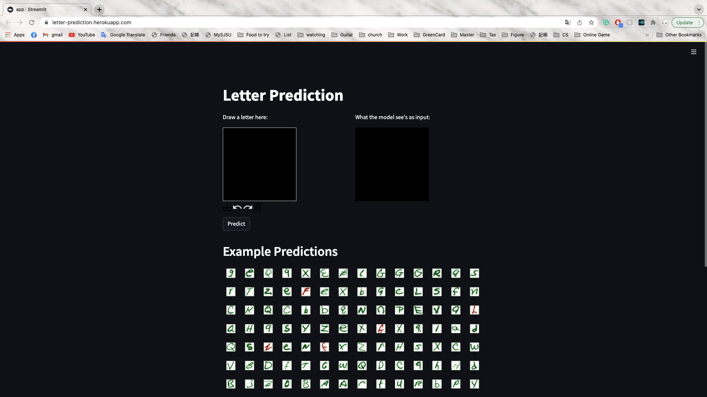
Deployment: Heroku
Deployment Link: https://letter-prediction.herokuapp.com/
Will introduce more in the live demo part coming up
app.py generated by our Google Colab file Including our Streamlit Front end and modeling
Requirements.txt and setup.sh to set up the environment
Procfile to tell Heroku to run the file

Slide 14
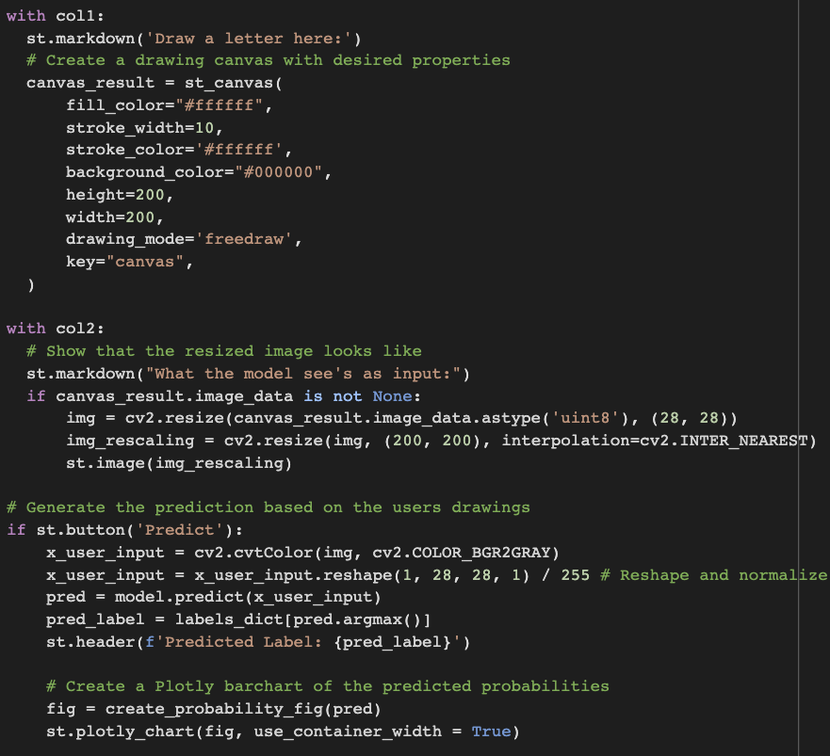
Front End Design
(Streamlit)
Main Features
User draws a letter
Custom ML model makes a class/letter prediction
Probability of labels displayed

Slide 15
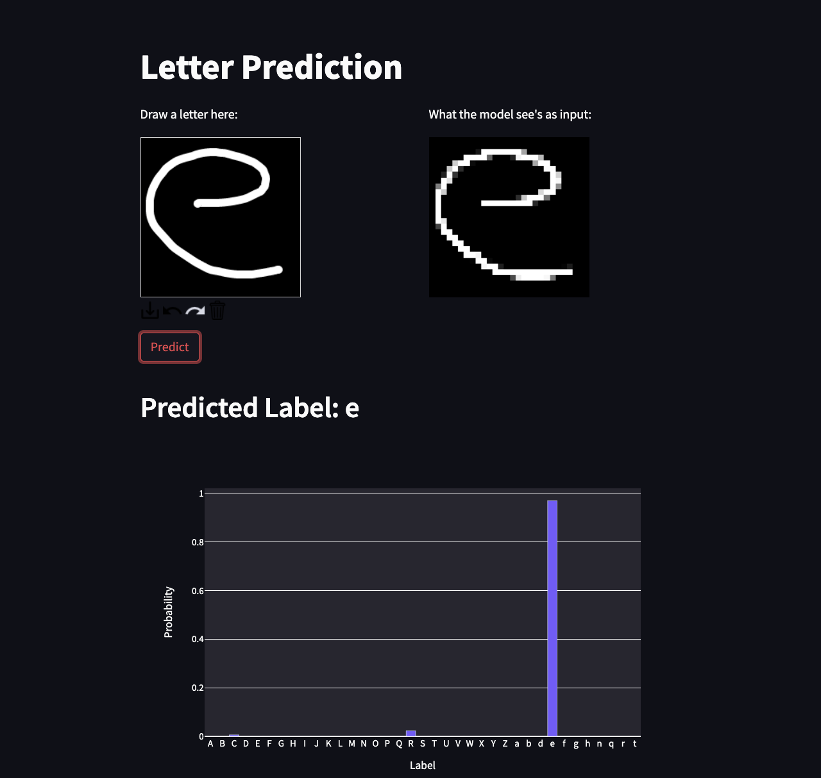
Live Demo
Heroku Hosted Demo:
https://letter-prediction.herokuapp.com/
Colab Demo:
https://github.com/coryroyce/emnist_letter_exploration_and_prediction/blob/main/streamlit_application/Streamlit_App.ipynb
* Can be run even if the demo app is no longer being actively hosted

Slide 16

Thank you!
Cory Randolph, Abraham Kong,
Akanksha Rawat, Karishma Kuria

